Slide 1
Much Ado About Precession
By Ian Cooper and Josh Kephart

Slide 2
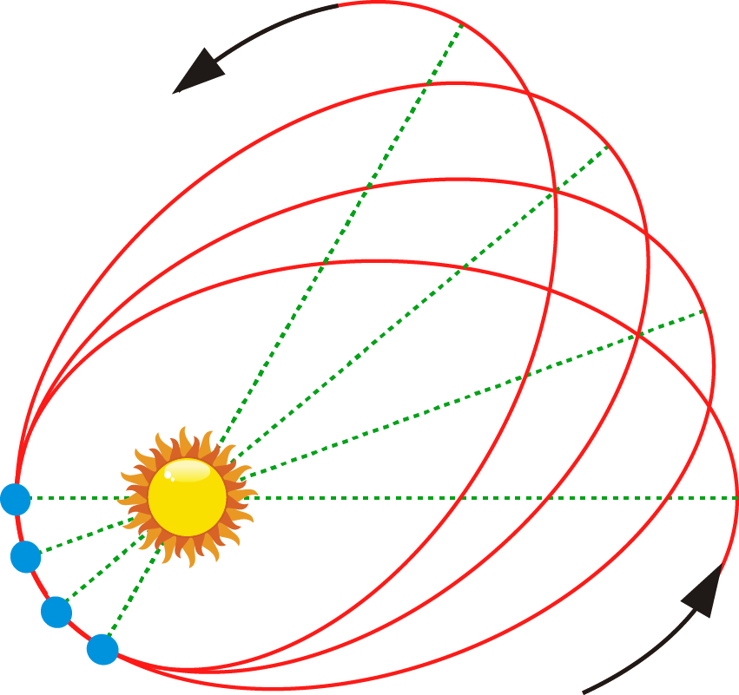
Some Background Information
Perihelion is the point closest to the sun in an elliptical orbit.
Precession is the rotation of the rotational axis of an orbit.
Several different types of precession, however we were interested in perihelion precession.

Slide 3
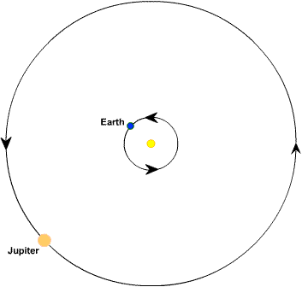
How Does it Work?
Primarily influenced by Newtonian interactions, i.e. the force of gravity.
Multiple planets in a system will pull on each other as they pass by one another.
The more elliptical the orbits, the higher the difference in torque between aphelion and perihelion.

Slide 4
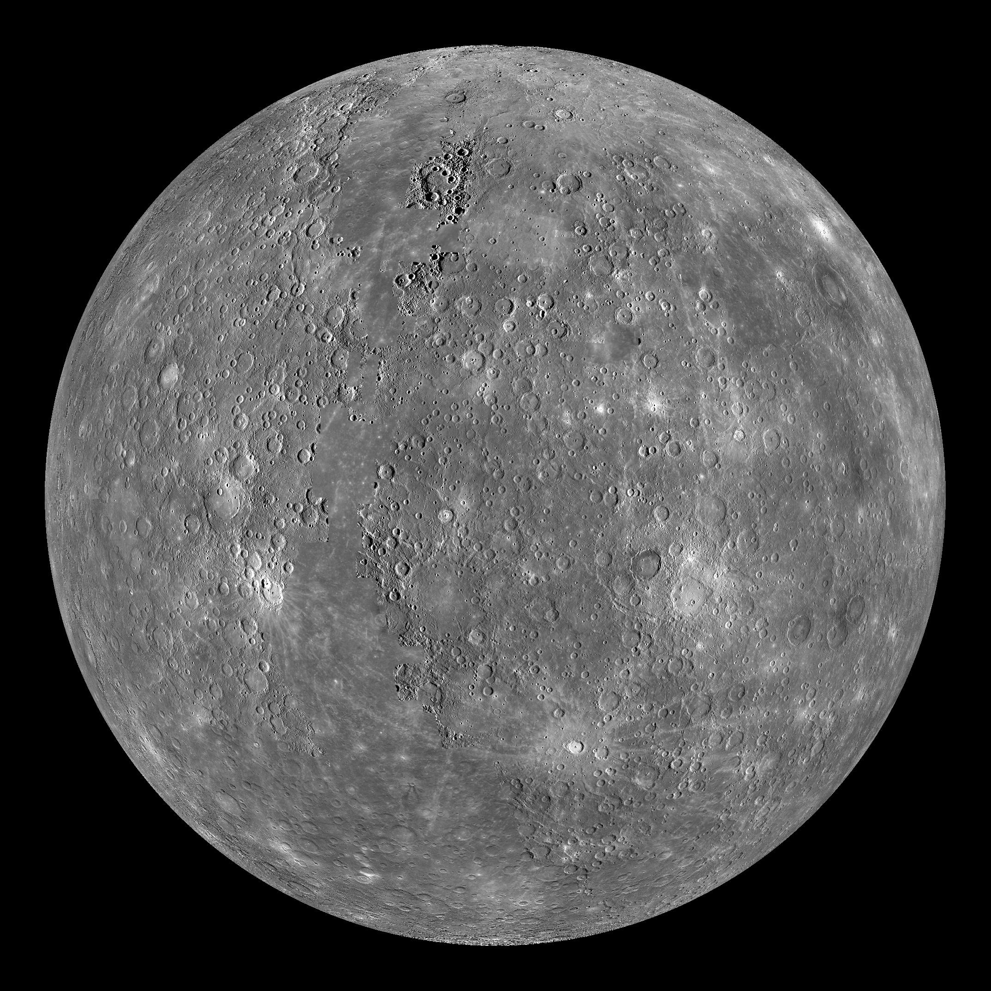
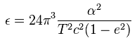
Sources of Precession
Newtonian interferences.
General relativity
Results in 43 arcsec/Julian Century for Mercury
Oblateness of the Sun. We see similar precession of the moon from the tidal bulge of the Earth. The effects on Mercury are almost negligible.
Total Precession of Mercury is 574 arcsec/Julian Century

Slide 5
Our Project
Generalize orbital ODE code for an arbitrary number of bodies with arbitrary initial conditions.
Animate the systems that the ODE integrator produced.
Focus in on the precession of orbits.
Examine what makes an orbit precess more or less, such as eccentricity or the mass of the interfering body.
Examine the precession rate of mercury and compare to the actual rate.

Slide 6
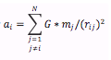
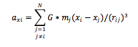
Equations
So to calculate the acceleration for the differential equations we use:
But we need to break this up into x and y components for 2d.
This means that if we want to plot a system of N bodies we need to take into account 2*N^2 calculations.

Slide 7
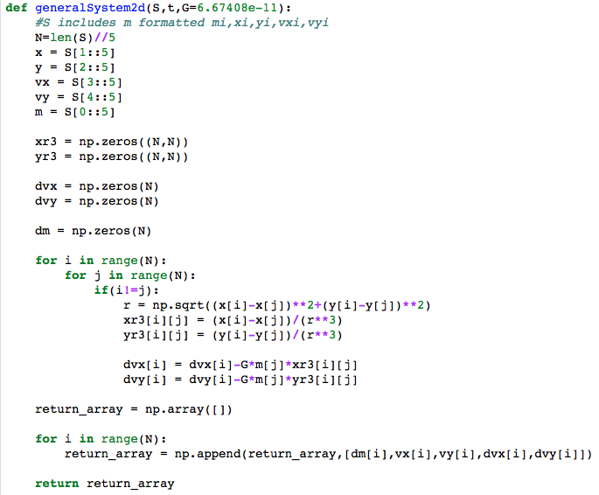

Slide 8


Slide 11
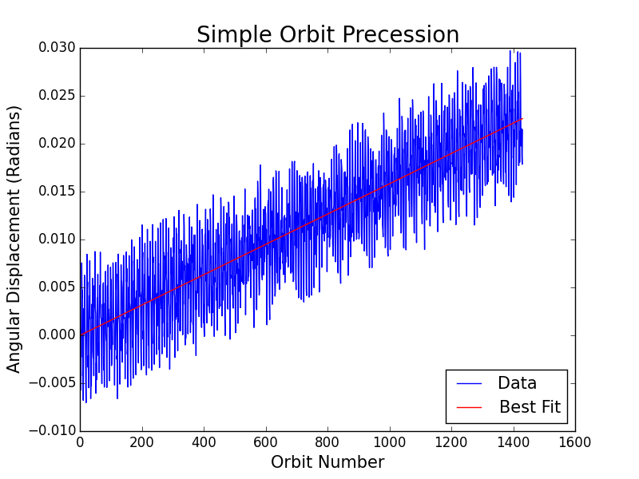
Examination of the precession
Slope = 1.58e-05 radians/orbits, or 7.14e-05 radians/earth year

Slide 12
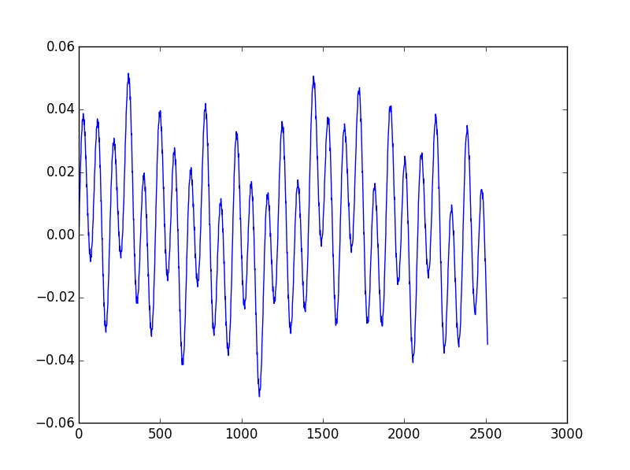
Mercury’s Precession
Mercury’s Orbit Precession
Angular Displacements (Radians)
Orbit Number

Slide 13
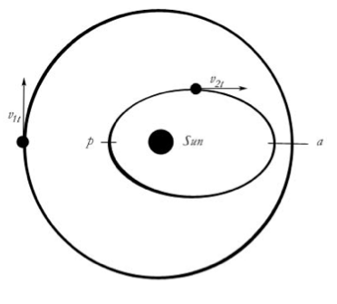
Future Work: Examining Changes in Precession
We Intend to examine what changes to the initial conditions of our simple precession plot result in for the slope of our precession over time plot.
We specifically wish to look at the eccentricity of the precessing orbit, and the mass of the interfering planet.
Predict that higher mass and eccentricity will result in a higher rate of precession.

Slide 14
References
https://jakevdp.github.io/blog/2012/08/18/matplotlib-animation-tutorial/
http://matplotlib.org/mpl_toolkits/mplot3d/tutorial.html
http://ssd.jpl.nasa.gov/horizons.cgi#top
https://en.wikipedia.org/wiki/Apsidal_precession
http://nssdc.gsfc.nasa.gov/planetary/factsheet/

Slide 15
Thank You

